Slide 1
GOM Wells Data Analysis
Overview and Progress
02 April 2018

Slide 2
Agenda
Introduction
Summary
Software Used
Data Available from BOEM
Basic resources
Major resources
Methodology
Data handling
Data visualization

Slide 3
Introduction
To identify the hydrocarbon discoveries with Paleogene age.
Find the wells which are in active leases.
Find the well related field status.
Find the block operator.
Plot the blocks and wells in google maps, showing operator details, lease start and end year.

Slide 4
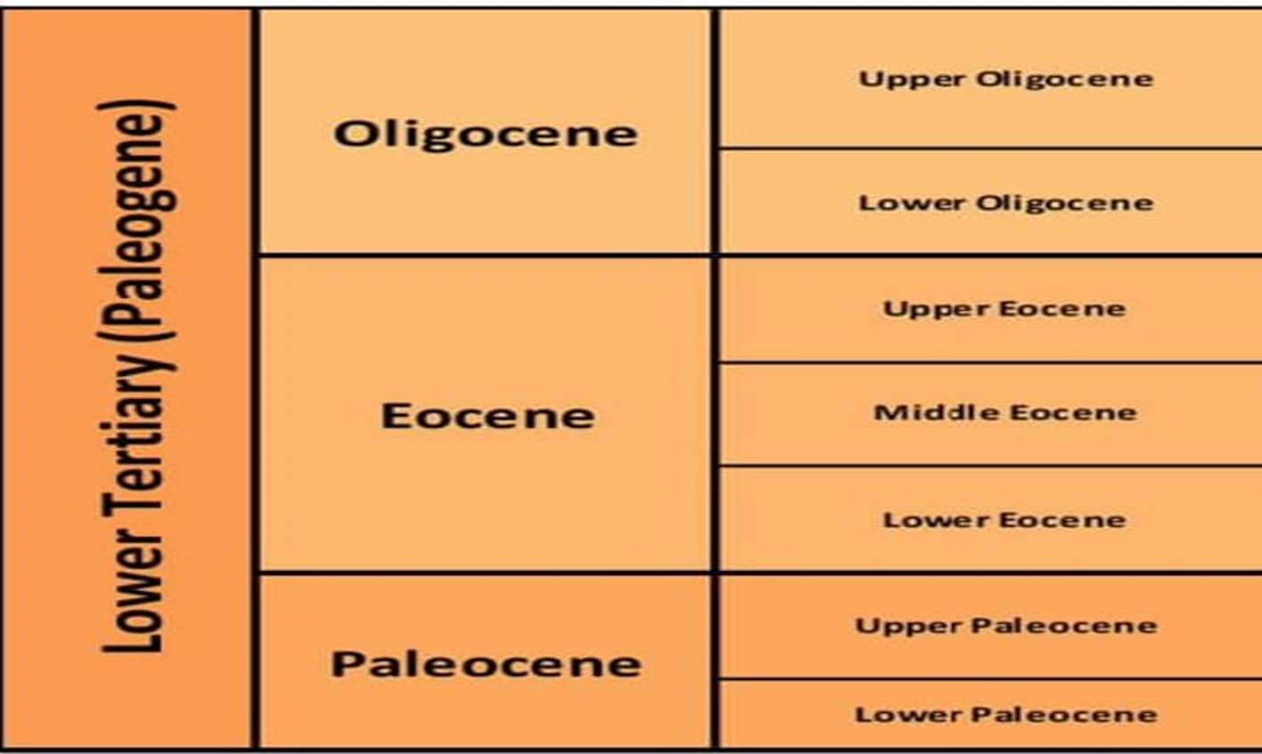
Summary
The Lower Tertiary is Palaeocene in age and known to be the most active age for sand deposition within the Deepwater Gulf of Mexico.
Showing different epochs in Lower tertiary period of Cenozoic era

Slide 5
Software Used
Module | software | Description | Comments
Xlrd | Python | Reading the data using excel file
Pandas | Python | Manipulating excel
Jupyter Notebook | Python | Python Notebook
Xlwt | Python | Writing the data to excel file

Slide 6
Data Availability From BOEM

Slide 7
Basic Resources
Gathering of wells data from the Database that officially placed publicly.
https://www.data.boem.gov/
Search for Gulf of Mexico resource Evaluation.
https://www.boem.gov/Oil-and-Gas-Energy-Program/Resource-Evaluation/Geological-and-Geophysical-Data-Acquisition/GGData-Gulf-of-Mexico.aspx/

Slide 8
Major Resources
Complete study of BOEM site and understanding the Geological Ages of the Formation
https://www.data.boem.gov/Main/Paleo.aspx/
https://www.data.boem.gov/Paleo/Files/biochart.pdf/
Identify wells data from Borehole raw data from BOEM
https://www.data.boem.gov/Well/Borehole/Default.aspx/

Slide 9
METHODOLOGY
Code Explanation

Slide 10
Data Handling
Data Automation from BOEM site.
Finding the Paleogene data by creating array using different Epochs.
Creating text document for the Paleogene wells after separation.
Finding the Lower tertiary wells based on well API Number by sorting out the duplicate values
Finding the company name, block number, block name and well status and respective latitude and longitude data by using well API number

Slide 11
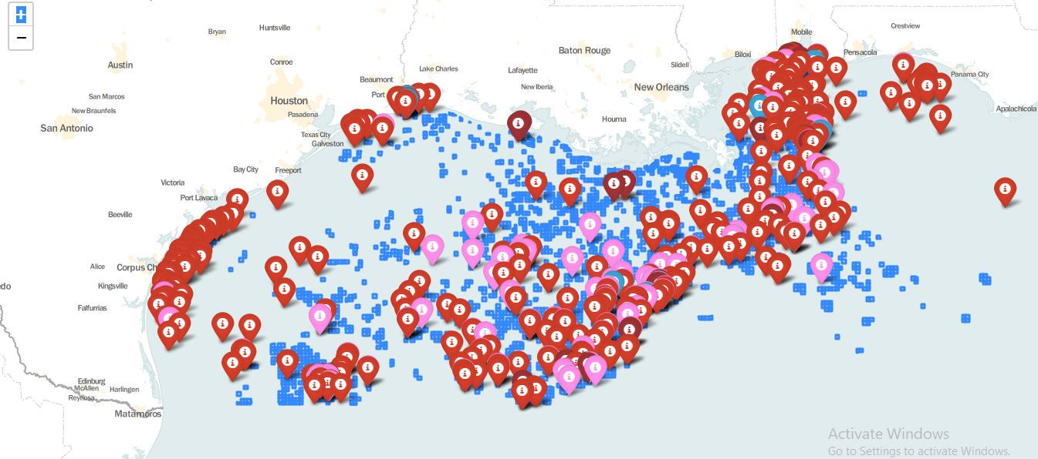
Data visualization
By using latitude and longitude data of wells making interactive maps using python modules
Based on different colouring defining well status

Slide 12
THANK YOU
For the opportunity to serve

